Slide 1
Daycare Center Business Plan

Slide 2
Scope and Coverage
Requirements
Competitors
Applications - Procare Solutions

Slide 3
Virginia Child Care Licensing Overview

Slide 4
Virginia Child Care Licensing Overview
Child care licensing in Virginia is managed by the Division of Child Care and Early Childhood Development (OECD).
Two types of child care licenses:
A Family Day Home (FDH) is a daycare program in either the care provider’s residence, or that of any of the children in care.
A Child Day Center (CDC) license applies to programs that provide daycare for at least two children in a facility other than the residence of the provider or a child in care, or for more than 12 children in any type of facility.

Slide 5
Virginia Child Care Licensing Overview
A child day program is a regularly operating service arrangement for children where, during the absence of a parent or guardian, a person or organization has agreed to assume responsibility for the supervision, protection and well-being of a child under the age of 13 years for less than a 24-hour period.
Virginia maintains a total of eight regional licensing offices which are located in Richmond, Fairfax, Warrenton, Virginia Beach, Newport News, Roanoke, Fishersville, and Abingdon.
Each office has at least one licensing administrator responsible for issuing licenses, overseeing licensing activities, and supervising licensing inspectors who are assigned to inspect and monitor children’s and/or adult programs.

Slide 6
Licensing Steps

Slide 7
Step 1. Understanding the License Requirements
Review the following:
Welcome Letter
General Procedures for Information and Licensure
Online child care licensing presentation (Phase I Training)
Schedule a free pre-licensure orientation session, known as Phase II training, with your regional licensing office, or call 1-800-543-7545

Slide 8
Step 2. Attend Phase II Training
The Phase II orientation session is conducted by state licensing inspectors, and is focused on exploring the Virginia state standards for your type of child care business.
Will be conducted at your own home. This should be done 60 days prior to actual application.
Notes:
What is the time frame of getting a inspection? Cost etc?
What type of licenses do the associates need to work in the business?

Slide 9
Step 3. Submit Your Child Care License Application
After completing Phase II training, you can submit your completed application package to your regional licensing office. A complete application includes all of the attachments listed above, plus relevant fees made out to the Treasurer of Virginia.

Slide 10
Step 4. Licensing Inspector Visit
A licensing inspector will be assigned to your child care program. The inspector will review your application and visit your center to determine whether you are in compliance with the standards that apply to you.
Major violations will require correction before licensing can proceed, but you may be allowed to continue with minor violations as long as you demonstrate your plan to correct them as soon as possible.

Slide 11
Step 5. Receive Your Virginia Child Care License
You will be issued a conditional license to operate a child care business for up to six months.
You will be subject to further, unannounced inspections. When the conditional period is over, you will receive your regular child care license, which you will need to periodically renew.

Slide 12
Additional Requirements for Child Day Center
A credit reference for the business agency
Three reference letters for each person listed on the relevant business information page
Documentation of liability insurance
Floor plans and site plan for the facility
A copy of the building’s Certificate of Use and Occupancy
A fire inspection report and Request for Building Evaluation or Inspection form
The Sanitation Inspection Report from the health department
If the building was constructed prior to 1978, an asbestos inspection
A Statement of Sponsorship and Organization outlining the structure of your business
Sample menu for one month
List of play equipment
Daily activity schedule

Slide 13
Provider/Child Ratio

Slide 14
Virginia Child Care Licensing Package
Child Day Center form
Background checks for yourself, all business partners, all caregivers
A tuberculosis screening report for yourself, all care providers
Copies of any written information, policies, procedures, brochures and forms used at your center
Documentation of the qualifications of the program director
An annual operating budget
Contact with Local Zoning Administrator (proof that the establishment is appropriately zoned to run a child care facility)
Notes:
Would need a website to run people background before being hired, what are the best ones and cost etc?

Slide 15
Application Fee & Staff Qualification

Slide 16
Child Day Center Application Fee
CHILD DAY CENTERS:
CAPACITY
1-12 = $14 13-25 = $35 26-50 = $70 51-75 = $105 76-200 = $140 201 and up = $200 Personal check, money order, or certified check must be made payable to “Treasurer of Virginia.” Fees are non-refundable. There will be a service charge of $50.00 for any check that must be returned due to insufficient funds.

Slide 17
Program director qualifications.
Program directors shall be at least 21 years of age and shall meet one of the following:
1. A graduate degree in a child-related field such as, but not limited to, elementary education, nursing, or recreation from a college or university and six months of programmatic experience;
2. An endorsement or bachelor's degree in a child-related field such as, but not limited to, elementary education, nursing, or recreation from a college or university and one year of programmatic experience;
3. Forty-eight semester hours or 72 quarter hours of college credit from a college or university of which 12 semester hours or 18 quarter hours are in child-related subjects and one year of programmatic experience;
4. Two years of programmatic experience with one year in a staff supervisory capacity and at least one of the following education backgrounds identified.
5. Three years of programmatic experience including one year in a staff supervisory capacity and fulfilled a high school program completion or the equivalent.

Slide 18
Program director qualifications.
Program directors without management experience shall have one college course in a business-related field, 10 clock hours of management training, or one child care management course that satisfactorily covers the management functions of:
1. Planning;
2. Budgeting;
3. Staffing; and
4. Monitoring.

Slide 19
Program director qualifications.
For program directors of therapeutic child day programs and special needs child day programs, education and programmatic experience shall be in the group care of children with special needs.
Notwithstanding subsection A of this section, a person between 19 and 21 years of age may serve as a program director at a short-term program serving only school age children if the program director has daily supervisory contact by a person at least 21 years of age who meets one of the program director qualification options.

Slide 20
Program Leader qualifications
Program leaders shall be at least 18 years of age, have fulfilled a high school program completion or the equivalent, and meet one of the following:
1. Have one of the program director qualifications in 22VAC40-185-190;
2. Have an endorsement or bachelor's degree in a child-related field such as, but not limited to, elementary education, nursing, or recreation, from a college or university;
3. Have three months of programmatic experience and at least one of the following education backgrounds:
a. A one year early childhood certificate from a college or university that consists of at least 30 semester hours;
b. A child development credential by an organization listed in § 63.2-1738 of the Code of Virginia;
c. A teaching diploma from an internationally or nationally recognized Montessori organization; or
4. Have six months of supervised programmatic experience. a. Within six months before being promoted or beginning work or one month after being promoted or beginning work, a minimum of 12 hours of training shall be received related to the care of children, including but not limited to: (1) Child development; (2) Playground safety; (3) Health and safety issues;

Slide 21
Program Leader qualifications
For program leaders of therapeutic child day programs and special needs child day programs, at least three months of programmatic experience shall be in the group
Notwithstanding the experience requirements in subsection A of this section, program leaders at short-term programs may have only one season of programmatic experience, provided that this experience shall include at least 200 hours, of which up to 24 hours can be formal training, working directly with children in a group.

Slide 22
Independent Contractors
Individuals from independent contractors shall not be counted in the staff-to-children ratios unless they meet the qualifications for the applicable position.
B. Individuals from independent contractors who do not meet staff qualifications shall, when in the presence of children, be within sight and sound supervision of a staff member.
C. Volunteers who work with children shall be at least 13 years of age.

Slide 23
Aides
Aides shall be at least 16 years of age.

Slide 24
Competitor Research

Slide 25
Competitors
All competitors have been observed to have (1) a program for each and every levels they cater to, and have (2) qualified personnel from caregivers to program director.
Price range of tuition fee for full-time child care is around $240 to $260 per week, or $960 to $1040 per month.
There’s only 1 licensed child care in Williamsburg.
All competitors are providing meals. The usual meals provided are breakfast, lunch, and 1 afternoon snack.
Most of the competitors offer programs for 6 weeks old babies to 12 year old school age children.
Some offers On-Location Care, or home-based child care for parents who doesn’t want to leave their house.

Slide 26
Competitors
There is one that offers subsidized child care program so that low-income families can be catered with child care.
All must comply with Americans with Disabilities Act.
Their facilities mostly include (1) toys area, (2) reading area, (3) activity area, (4) infant area, (5) play area, and (6) story time area.
Programs include (1) outdoor play, (2) indoor activities, (3) meal plans, (4) nap time, (4) self care, (5) songs, (6) basic skills improvement.
They are offering fulltime, part time, and after school child care. Some are also offering camps.
Most programs focus on (1) personal development, (2) exploration, and (3) learning about others.
Initial Competitor Research Link

Slide 27
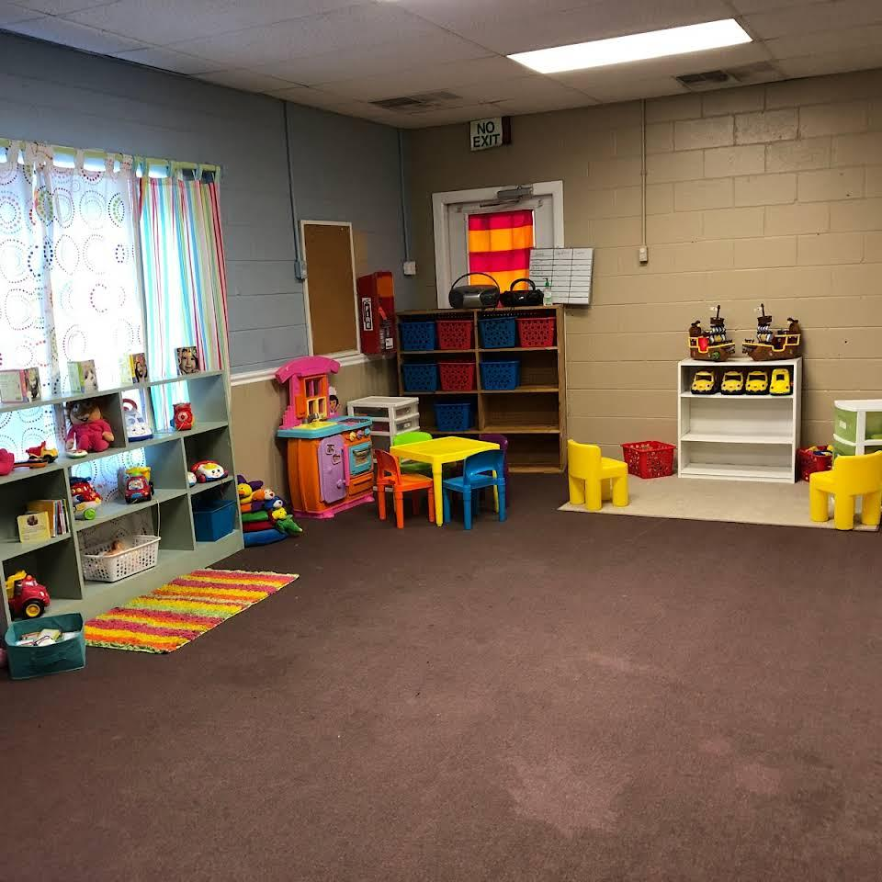
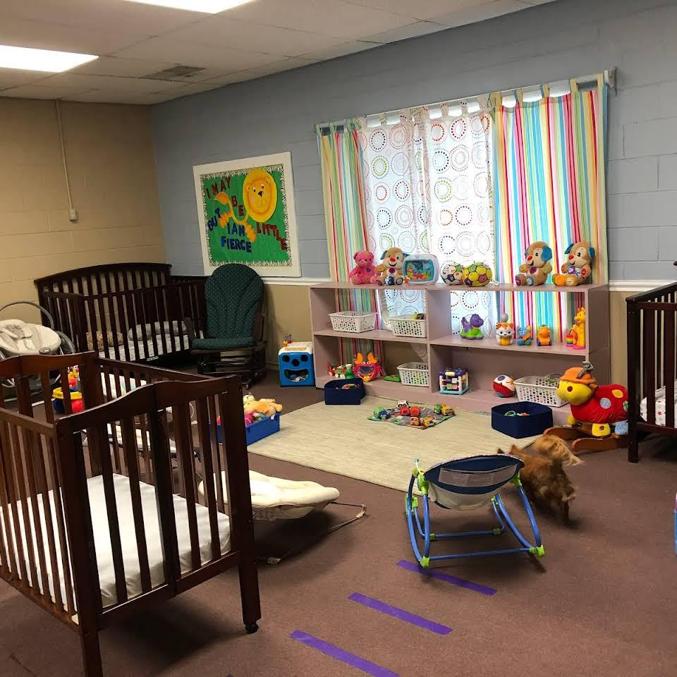
Playrooms

Slide 28
Events and Outdoor Activities

Slide 29
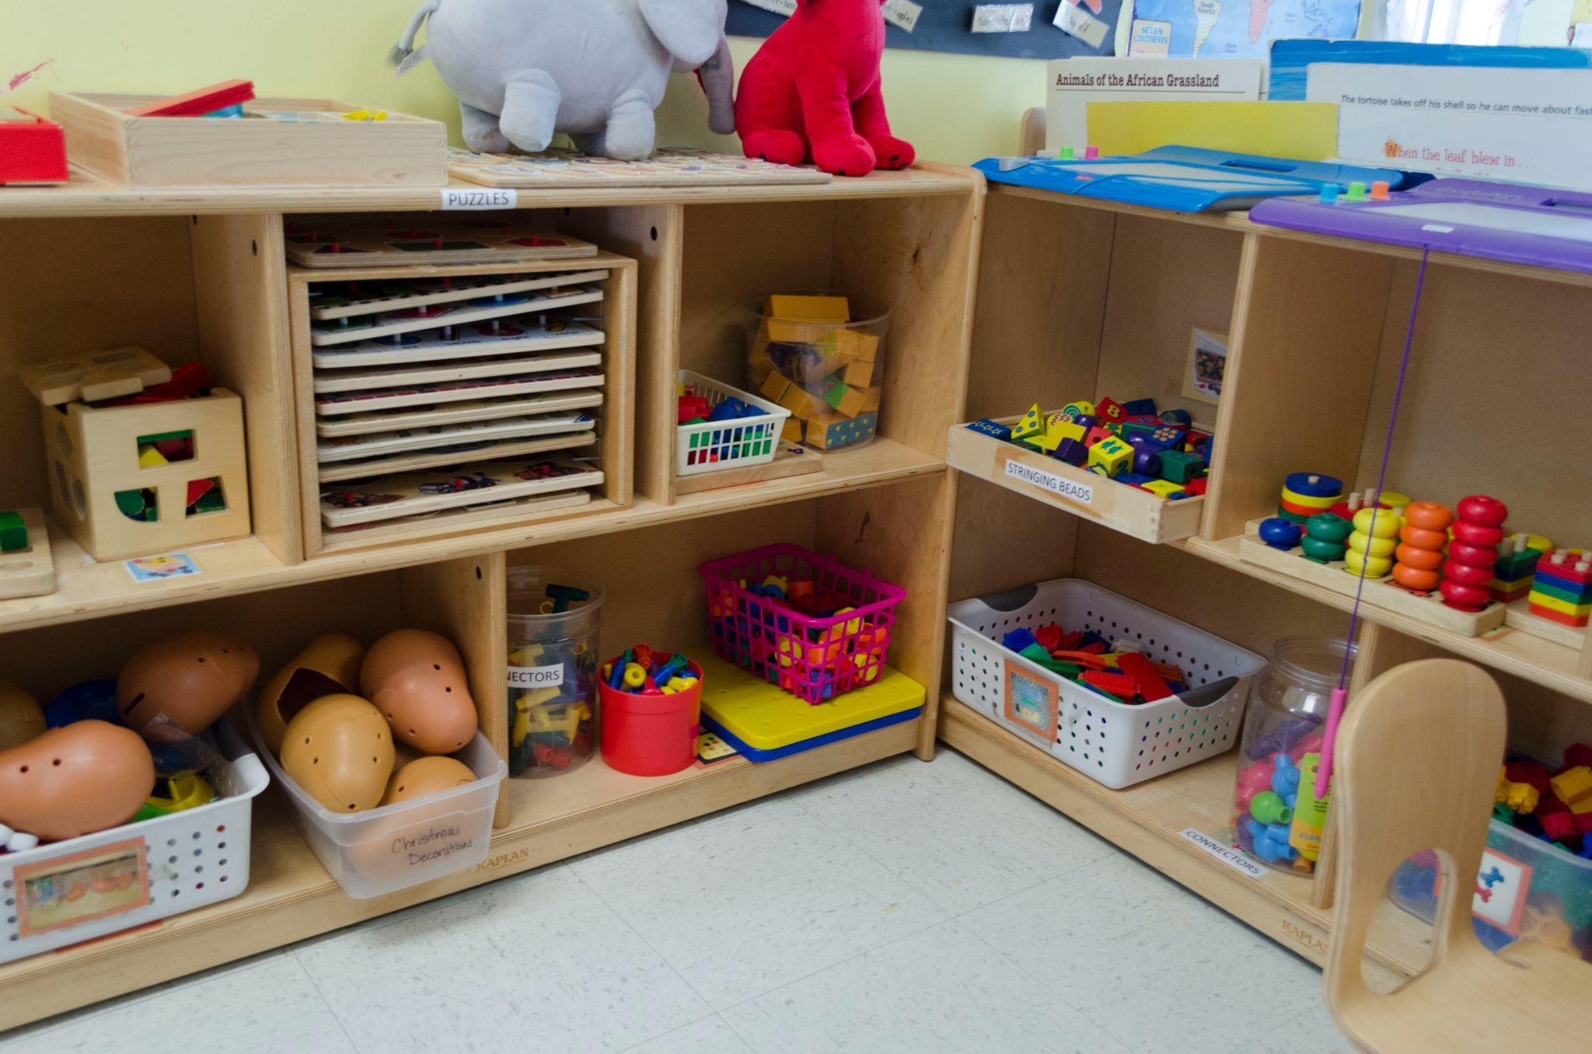
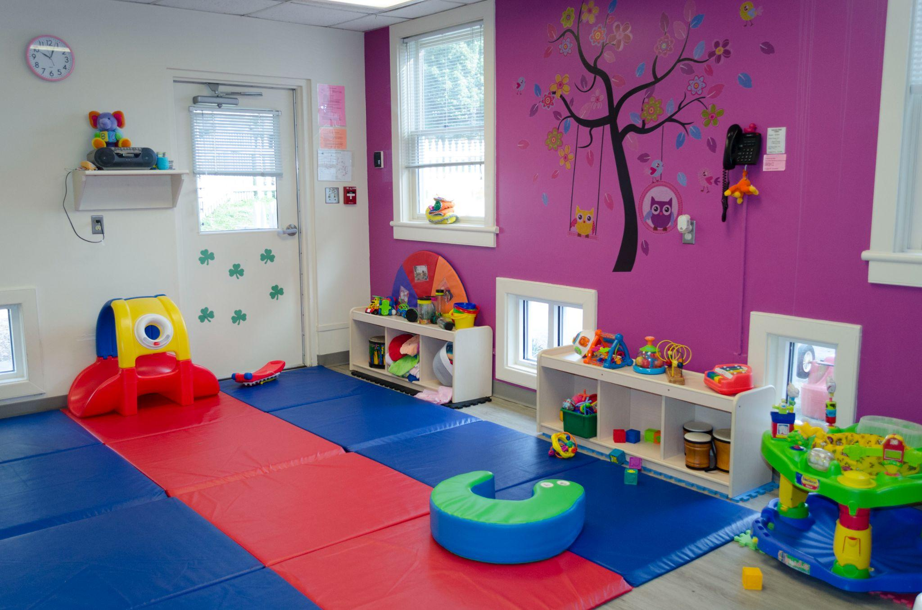
Sensory Toys and Play Room

Slide 30
Applications / CRMs

Slide 31
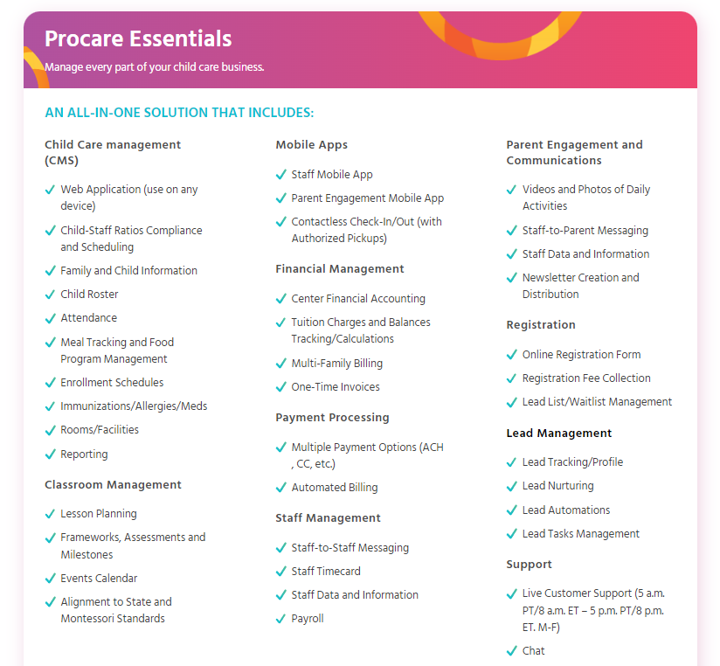
Applications - Procare Solutions

Slide 32
Applications - Procare Solutions
Child Care Business Management
Plan curriculum and activities. Plan weekly lessons, manage curriculum and assess children’s developmental progress, as well as create and manage child care activities, classes, camps or programs.
Track child-staff ratios. With our real-time staff and student attendance system, you can easily track ratios and ensure you are always licensing-compliant. You can also set up alert monitoring to get notified when you’re overstaffed or understaffed.

Slide 33
Applications - Procare Solutions
Child Care Business Management
From invoicing, billing, and payments to family and child data to staff and student-to-staff ratios, everything you need is in one place. Real-time charges based on attendance.
Automated Payment Processing. Touchless payment option is available.
Simplify child care administration by allowing quick access to parent and child records.
Procare gives you the tools you need to easily track meals served for breakfast, lunch, dinner and snacks.

Slide 34
Applications - Procare Solutions
Parent Engagement
Track attendance and any room movement. Make it easy for teachers to track child activity with name-to-face reporting.
Track In-Class Activities & Development Milestones. Create daily activities that can then be communicated with parents, and connect those activities to state standards
Share daily activities, videos, photos and newsletters with parents. Use the parent communication app for easy, two-way communication. Keep parents engaged with calendars to promote upcoming events

Slide 35
Applications - Procare Solutions
Secured and Contactless
Procare’s Keyless Entry System keeps a live record of who enters your building, allowing you to monitor building access in real time or by printing a daily log.
Biometric and fingerprint technology ensures only authorized caregivers can pick up or drop off the children in your care.
With Procare’s Keyless Entry System, unique ID codes are assigned to each person.
Parents can easily check their children in and out using Procare’s smartphone app.

Slide 36
Applications - Procare Solutions
Secured and Contactless
Procare’s Interior Door Controller provides secure access to designated doors using a check-in/out computer or Procare Touch device—providing zone control access and the ability to grant or remove access to anyone at any time.

Slide 37
Applications - Procare Solutions
Tuition Collection and Payment
This child care billing software gives your child care center all of the touchless payment options you need — electronic fund transfer (EFT), online or completely automated.
Payment at Check-in is also available. Allow parents to quickly and easily make payments as they check their children in to your center. Payments are posted directly to your parents’ ledgers in Procare, and receipts are emailed automatically.
Accept Visa, MasterCard, Discover, AMEX
Notes:
For payment google pay and apple pay, does this allow that?

Slide 38
Applications - Procare Solutions
Staff Management
Make staff clock in/out, scheduling and payroll a breeze using Procare’s Staff Management tools.
Allows you to schedule, track hours and benefits, administer payroll and maintain staff information easily and seamlessly.
Maintain payroll records, calculate paychecks, and generate reports and insights for your back-office needs.
Customize your staff’s access to the data and functionality available in the Procare platform. Assign levels of authorization based on staff’s roles and responsibilities.
Notes:
Does this have a auto link for when we file taxes it is done automatically?

Slide 39
Procare Demo
Check out their Demo on this Youtube Channel

Slide 40
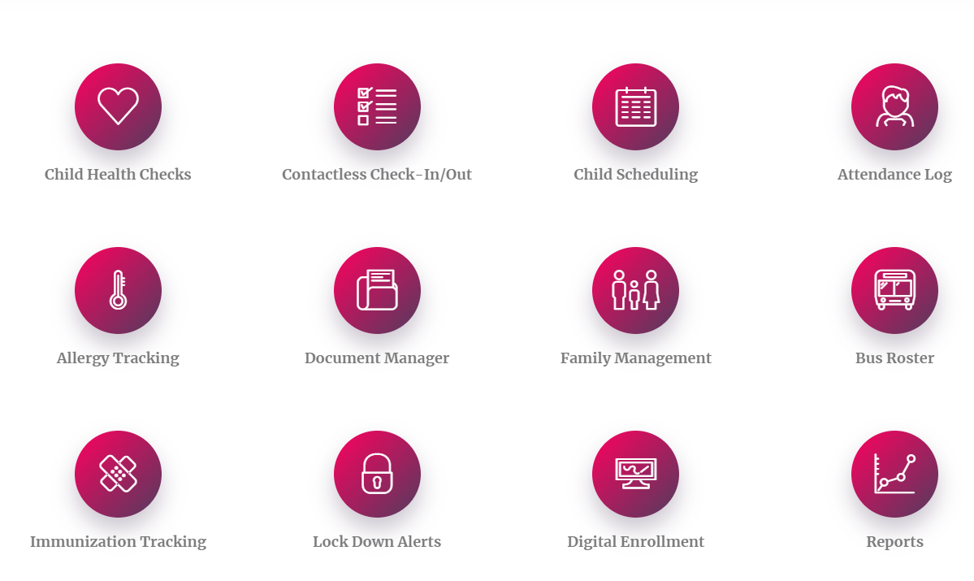
Kangarootime
Check out their Demo on this Youtube Channel

Slide 41
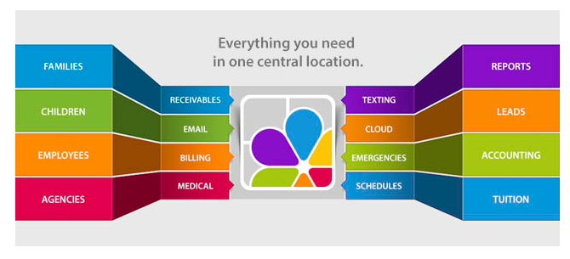
ChildCare Manager - SmartCare
Check out their Demo on this Youtube Channel

Slide 42
Next Topics to Cover
Market Study
Staff Requirements and Median Pay
Operating Expenses and Subscription Cost
Marketing Strategy
Creation of Business Plan (With Financial Projections)

